Slide 1



TATA VISUALIZATION : Empowering Business
with Effective Insights
Project Title :-Online retail analysis

Slide 2
Today's agenda
Project recap
Problem
The Analytics team
Process
Insights
Summary

Slide 3

Project Recap
The virtual experience program is provided by Tata IQ or Tata Insights and Quants. I discover how passionate, multidisciplinary experts utilize data visualization technologies like Tableau and Power BI to take on some of the most difficult business problems and uncover fascinating insights buried in the mountains of produced data.
The program demonstrates the kind of issues dealt with by Tata Insights and Quants every day and makes an effort to imitate the difficulties an individual could have. There are 4 modules in this virtual Internship program for online retail data analysis.
♦ Framing the Business Scenario
♦ Choosing the Right Visuals
♦ Creating Effective Visuals
♦ Communicating Insights and Analysis

Slide 4
Process:-
1
Data Understand
2
Data Cleaning
3
Data Modelling
4
Data Analysis
5
Uncover Insights

Slide 5
Data flowchart
Description
Unit price
Invoice date
INVOICE NO
Stock code
Customer ID
Quantity
COUNTRY

Slide 6
Question-01
The CEO of the retail store is interested to view the time series of the revenue data for the year 2011 only. He would like to view granular data by looking into revenue for each month. The CEO is interested in viewing the seasonal trends and wants to dig deeper into why these trends occur.This analysis will be helpful for the CEO to forecast for the next year.

Slide 7
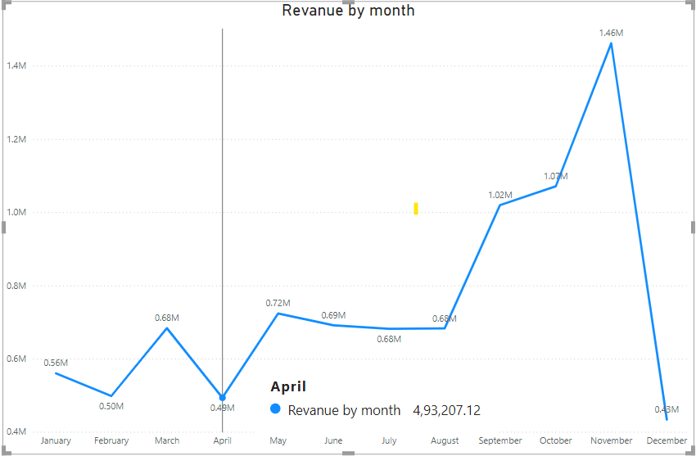
first question, the CEO has requested a trend of the revenue to see if there is any seasonality in the store sales. My analysis shows that there are some months of the year were exceptional growth is witnessed. The data shows that the revenue in the first 8 months is fairly constant as the average revenue generated for these 8 months is around $685k. The increase in revenue starts in the month of September, where the revenue increases by 40% over the previous month. This trend continues till the month of November where it reached 1.5 million USD, the highest during the entire year. The data is incomplete for the month of December, therefore, no conclusion can be drawn from it, unfortunately. This analysis shows that the retail store sales are impacted by the seasonality which usually occurs in the last 4 months of the year.
Insights

Slide 8
Question-02
The CMO is interested in viewing the top 10 countries which are generating the highest revenue. Additionally, the CMO is also interested in viewing the quantity sold along with the revenue generated. The CMO does not want to have the United Kingdom in this visual.

Slide 9
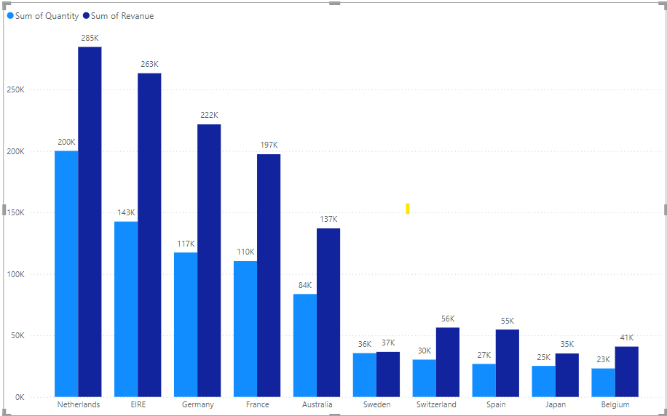
Insights
The second visual shows how the top 10 countries which have opportunities for growth are performing. This data does not include the UK as the country already has high demand and I’ve been told you’re more focused on the countries where demand can be increased. The analysis shows that countries such as the Netherlands, Ireland, Germany and France have high volumes of units bought and revenue generated. I would suggest that these countries should be focused on to ensure that measures are taken to capture these markets even more.

Slide 10
Question-03
The CMO of the online retail store wants to view the information on the top 10 customers by revenue. He is interested in a visual that shows the greatest revenue generating customer at the start and gradually declines to the lower revenue generating customers. The CMO wants to target the higher revenue generating customers and ensure that they remain satisfied with their products.

Slide 11
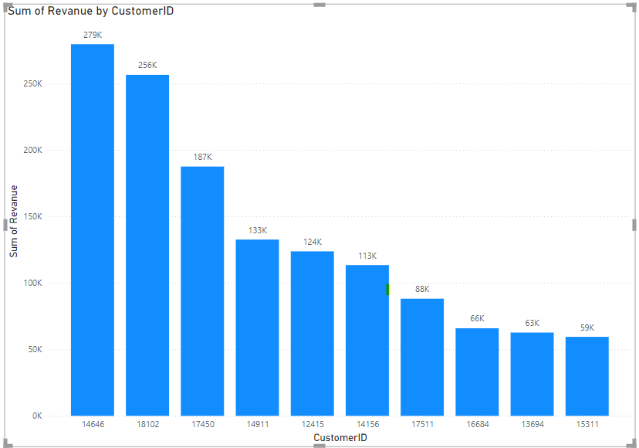
Insights
The third analysis has been performed on the top 10 customers who have purchased the most from the store. The data shows that there is not much of a difference between the purchases made by the top 10 customers. The highest revenue generating customer only purchased 17% more than the 2nd highest which shows that the business is not relying only on a few customers to generate the revenue. This shows that the bargaining power of customers is low and the business is in a good position.

Slide 12
Question-04
The CEO is looking to gain insights on the demand for their products. He wants to look at all countries and see which regions have the greatest demand for their products. Once the CEO gets an idea of the regions that have high demand, he will initiate an expansion strategy which will allow the company to target these areas and generate more business from these regions. He wants to view the entire data on a single view without the need to scroll or hover over the data points to identify the demand. There is no need to show data for the United Kingdom as the CEO is more interested in viewing the countries that have expansion opportunities.

Slide 13
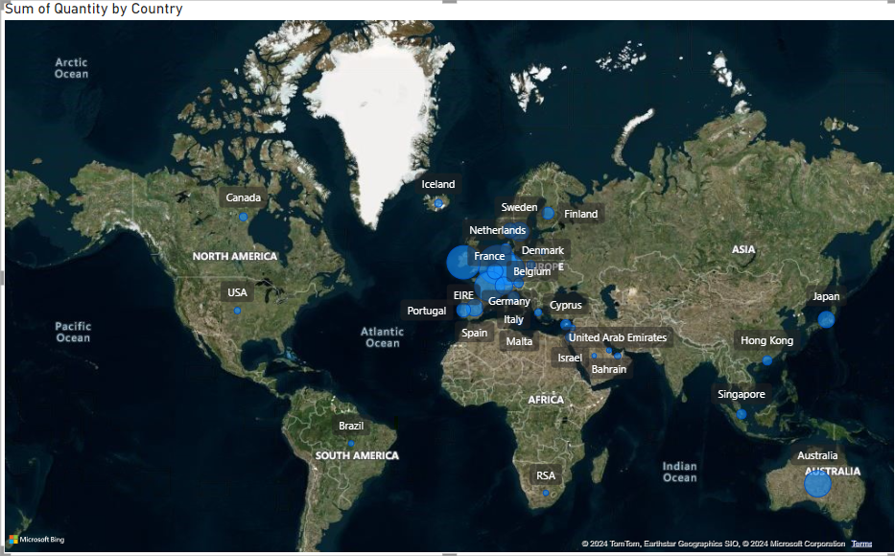
Finally, the map chart shows the regions that have generated the most revenue compared with the regions that have not. It can be seen that apart from the UK, countries such as Netherlands, Ireland, Germany, France and Australia are generating high revenue and the company should invest more in these areas to increase demand for products. The map also shows that most of the sales are only in the European region with very few in the American region. Africa and Asia do not have any demand for the products, along with Russia. A new strategy targeting these areas has the potential to boost sales revenues and profitability.
Insights

Slide 14
THE END
THANK YOU

